Slide 1
Hardware Load Balancing

Slide 2
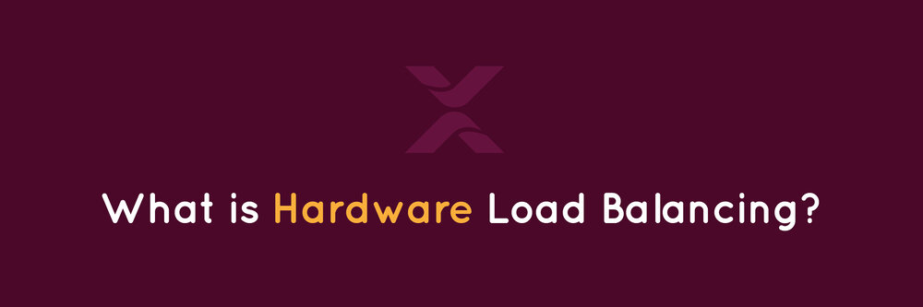

Slide 3
Introduction
Load balancing is a generic term used for distributing a larger processing load to smaller processing nodes for enhancing the overall performance of system.
The main goal of a load balancing algorithm in a cloud computing environment is to improve the response time of job by distributing the total load of system. The algorithm must also ensure that it is not overloading any specific node.

Slide 4


Slide 5
Assumptions
1. Proportionality — The effect of a decision variable in any one equation is proportional to a constant quantity.
2. Additivity — The combined effect of the decision variables in any one equation is the algebraic sum of their individual weighted effects. (The weighting, of course, is due to the proportionality constants.)
3. Certainty — All model parameters are known constants.
4. Each virtual machine has maximum number of hours

Slide 7
Solution approach
1-Figure out the problem you're trying to solve
2-Analyze the problem
3-Classify the decision criteria
4-Come up with more than one solution
5-Pick the best solution

Slide 8
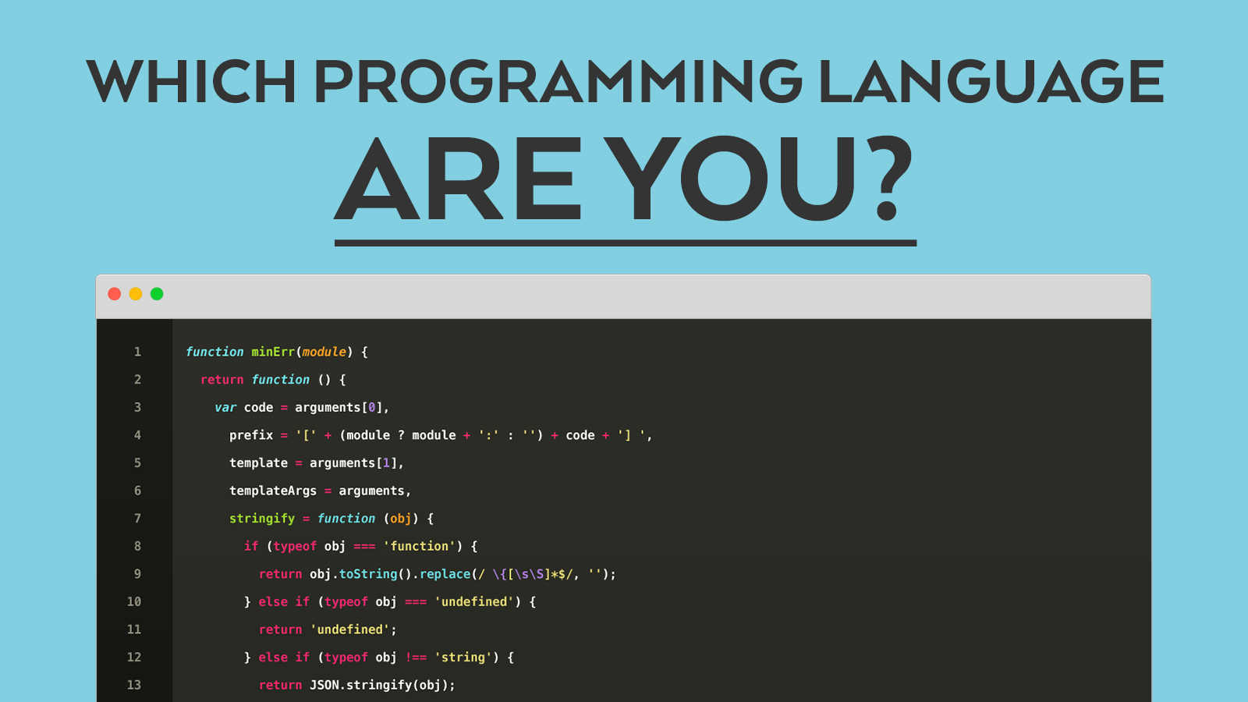
We should use

Slide 9
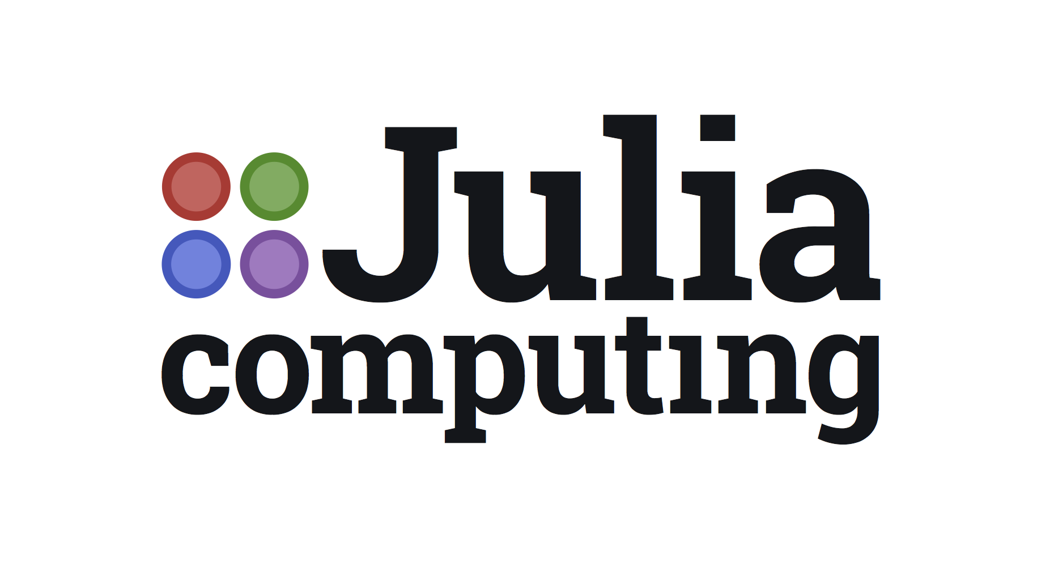

Slide 10
Why Julia/JuMP?
When coded well, it is very fast
Clear, concise code that can easily be changed
Great ability to mix loop based & matrix/vector operations
JuMP depends on solvers to solve optimization problems

Slide 11
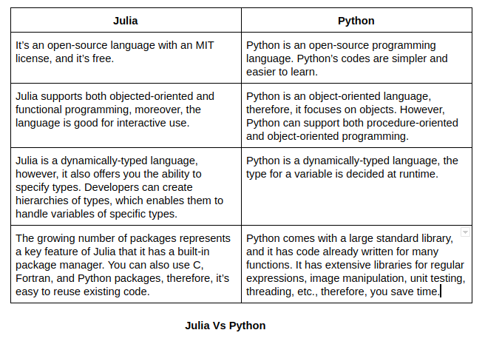
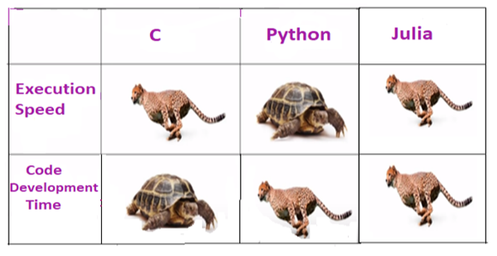

Slide 12
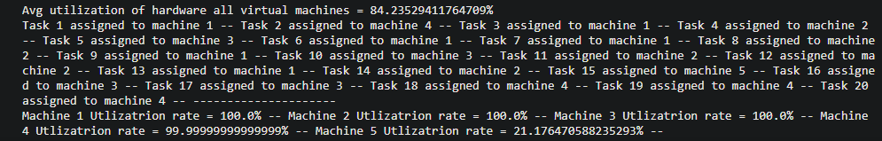
Results
20 Tasks
5 Virtual machines
Machines Limit 10

Slide 13


Slide 14
Overall Recommendation
It’s recommended to use hardware balancing for enhancing the overall performance of the system it’s an important step to successfully optimizing your server resources. By tracking virtual machines, you gain information that is indispensable for capacity planning. This way you can ensure optimal server performance every day and minimize potential server performance issues and maximize resource utilization. It’s recommended to use Julia modeling language in this model because it supports a number of open-source and commercial solvers and suitable for a variety of problem classes, including linear programming, mixed-integer programming and nonlinear programming.

Slide 15
Thanks!

